Slide 1
Student meeting 19th September 2019 Jana
AlphaPart: R-package for partitioning genetic trend
Reallocation of resources:
Reallocate money from phenotyping to genotyping

Slide 2

AlphaPart
Pig breeding examples: nucleus + reproduction
Models:
Intercept + animal
Tier + generation (fixed) + animal (random)
Tier * generation (fixed) + animal (random)
Fixed the generation + tier model

Slide 3
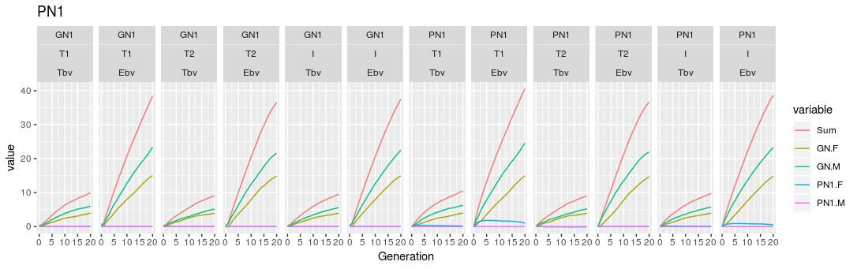
AlphaPart
Fixed the generation + tier model
Partition, h² = 0.25

Slide 4
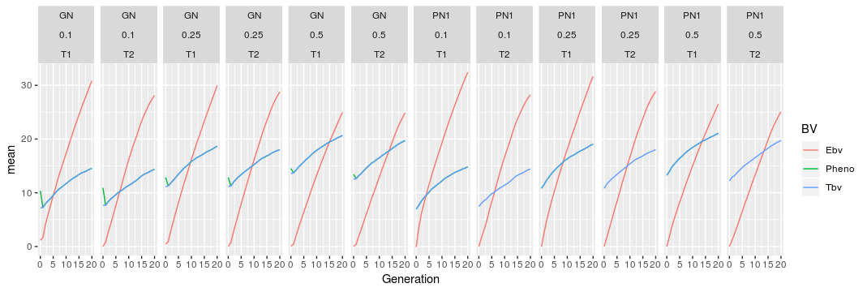
AlphaPart
Genetic trend: fixed effects model

Slide 5
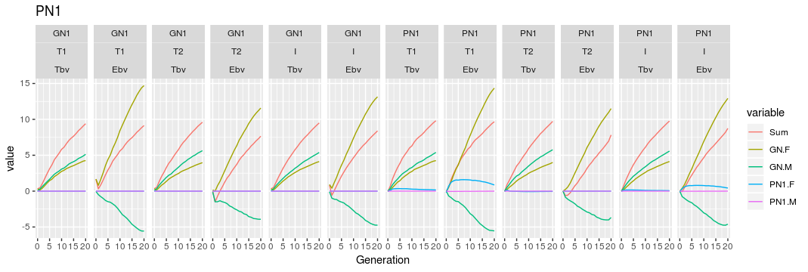
AlphaPart
Did not fix the intercept model
Partition, h² = 0.25

Slide 6
AlphaPart
Genetic trend: intercept model

Slide 7
Rellocation of resources
Baseline: conventional selection, 11 recordings of phenotype / lactation
Genomic scenarios - variables:
Initial training population: yes / no
# phenotype recordings / lactation (10, 9, 8, 5, 2, 1)
Price of genotype vs price of phenotype

Slide 8
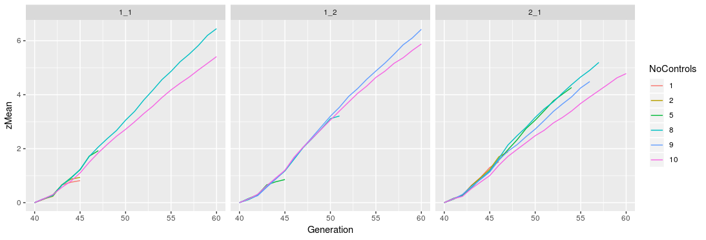
Rellocation of resources
Ran the reference:yes scenarios (18) – one test rep
Scenarios failes: too many animals for blupf90
Price phenotype =
price genotype
Cheap genotype
Expensive genotype

Slide 9
Rellocation of resources
Questions:
Keep last X generations of genotypes / keep them all
Options:
Limit the number of genotyped animals
Get unlimited blupf90 + APY for large training set

